Slide 1
15 Power Series, Taylor Series

Slide 2
15.1 Sequences, Series, and Convergence Tests

Slide 3
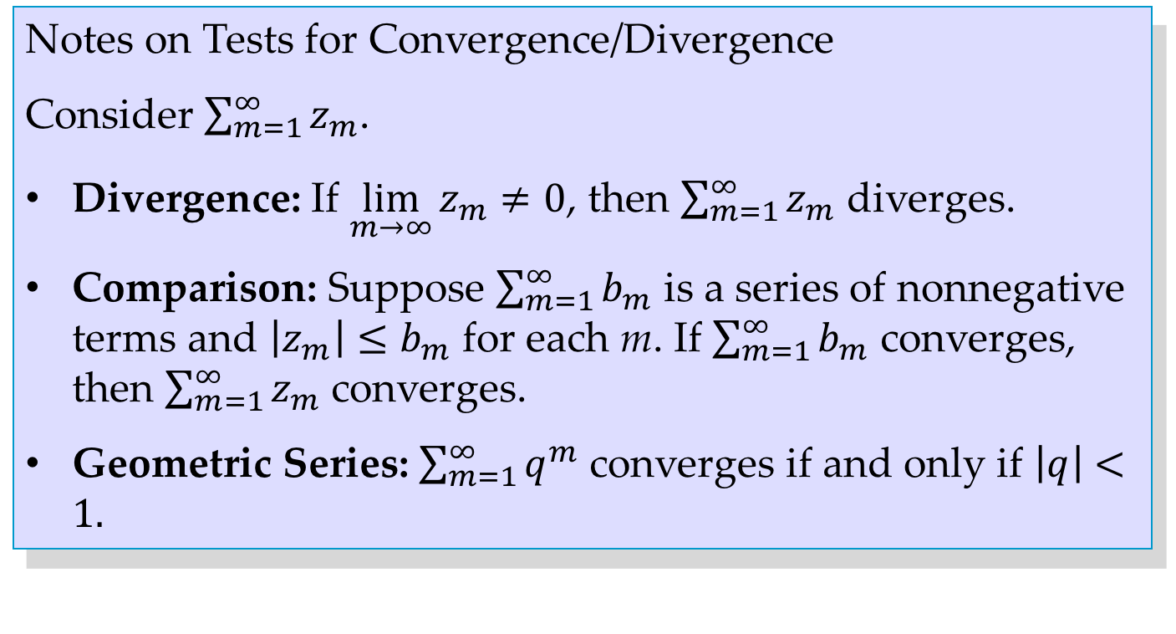
Notes on Tests for Convergence/Divergence
Consider $\sum_{m=1}^{∞}{z_{m}}$.
Divergence: If $\lim_{m→∞}{z_{m}≠0}$, then $\sum_{m=1}^{∞}{z_{m}}$ diverges.
Comparison: Suppose $\sum_{m=1}^{∞}{b_{m}}$ is a series of nonnegative terms and $\left|z_{m}\right|≤b_{m}$ for each m. If $\sum_{m=1}^{∞}{b_{m}}$ converges, then $\sum_{m=1}^{∞}{z_{m}}$ converges.
Geometric Series: $\sum_{m=1}^{∞}{q^{m}}$ converges if and only if $\left|q\right|<1.$
Notes:
’nonnegative real terms”

Slide 4
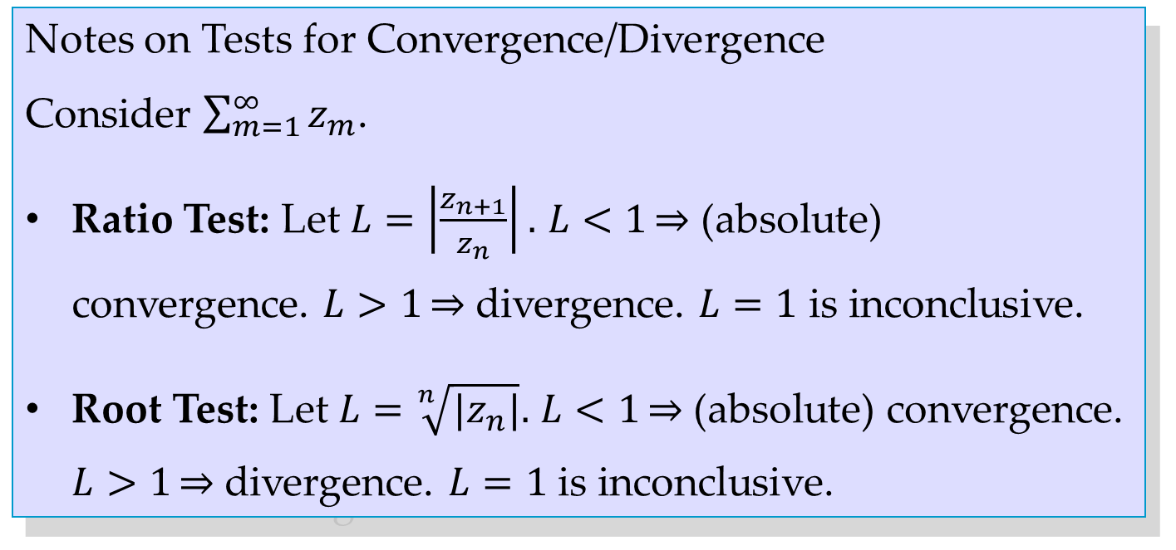
Notes on Tests for Convergence/Divergence
Consider $\sum_{m=1}^{∞}{z_{m}}$.
Ratio Test: Let $L=\left|\frac{z_{n+1}}{z_{n}}\right|.$ $L<1\underset{⇒}{}$ (absolute) convergence. $L>1\underset{⇒}{}$ divergence. $L=1$ is inconclusive.
Root Test: Let $L=\sqrt[n]{|z_{n}|}.$ $L<1\underset{⇒}{}$ (absolute) convergence. $L>1\underset{⇒}{}$ divergence. $L=1$ is inconclusive.
Notes:
OK to here

Slide 5
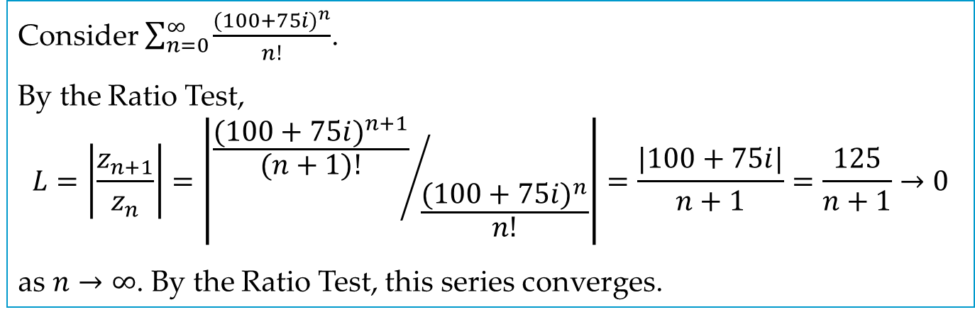
EXAMPLE 4
Consider $\sum_{n=0}^{∞}{\frac{{(100+75i)}^{n}}{n!}}$.
By the Ratio Test,
$$L=\left|\frac{z_{n+1}}{z_{n}}\right|=\left|{\frac{{(100+75i)}^{n+1}}{(n+1)!}}/{\frac{{(100+75i)}^{n}}{n!}}\right|=\frac{|100+75i|}{n+1}=\frac{125}{n+1}→0$$
as $n→∞$. By the Ratio Test, this series converges.

Slide 6
15.2 Power Series

Slide 7
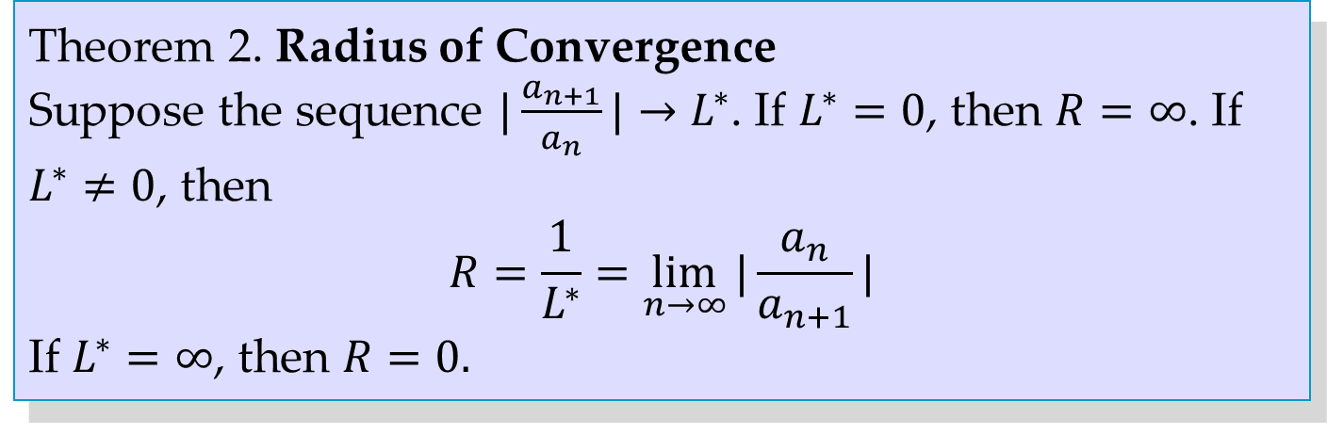
Theorem 2. Radius of Convergence
Suppose the sequence $|\frac{a_{n+1}}{a_{n}}|→L^{∗}$. If $L^{∗}=0$, then $R=∞$. If $L^{∗}≠0$, then
$$R=\frac{1}{L^{∗}}=\lim_{n→∞}{|\frac{a_{n}}{a_{n+1}}|}$$
If $L^{∗}=∞$, then $R=0.$
Notes:
Need to specify that n = 1, 2, …, ?

Slide 8
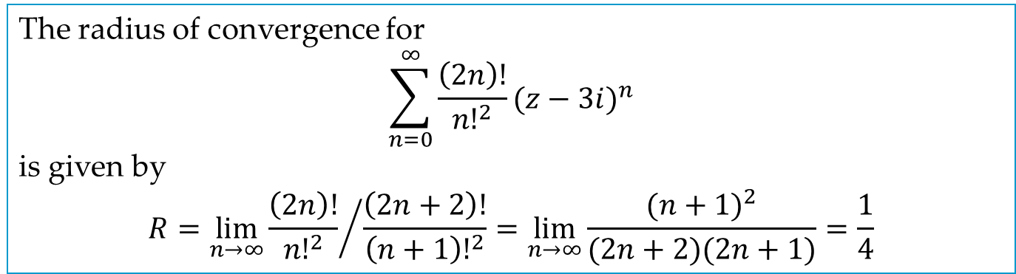
EXAMPLE 5
The radius of convergence for
$$\sum_{n=0}^{∞}{\frac{\left(2n\right)!}{{n!}^{2}}{(z−3i)}^{n}}$$
is given by
$$R=\lim_{n→∞}{{\frac{\left(2n\right)!}{{n!}^{2}}}/{\frac{\left(2n+2\right)!}{{\left(n+1\right)!}^{2}}=\lim_{n→∞}{\frac{{(n+1)}^{2}}{(2n+2)(2n+1)}}=\frac{1}{4}}}$$

Slide 9
15.3 Functions Given by Power Series

Slide 10
Theorem 3. Termwise Differentiation of a Power Series
The derived series of a power series has the same radius of convergence as the original series.

Slide 11
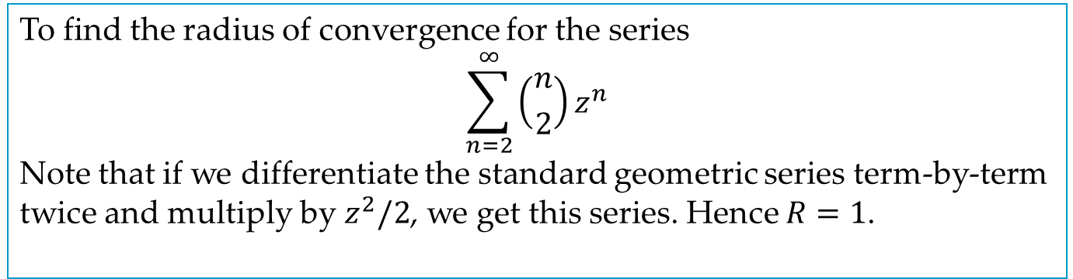
EXAMPLE 1
To find the radius of convergence for the series
$$\sum_{n=2}^{∞}{\left({n \atop 2}\right)}z^{n}$$
Note that if we differentiate the standard geometric series term-by-term twice and multiply by $z^{2}/2$, we get this series. Hence $R=1$.

Slide 12
Theorem 5. Analytic Functions, Their Derivatives
A power series with a nonzero radius of convergence R represents an analytic function at every point interior to its circle of convergence. The derivatives of this function are obtained by differentiating the original series term-by-term. All the series thus obtained have the same radius of convergence as the original series. Hence, each of them represents an analytic function.

Slide 13
15.4 Taylor and Maclaurin Series

Slide 14
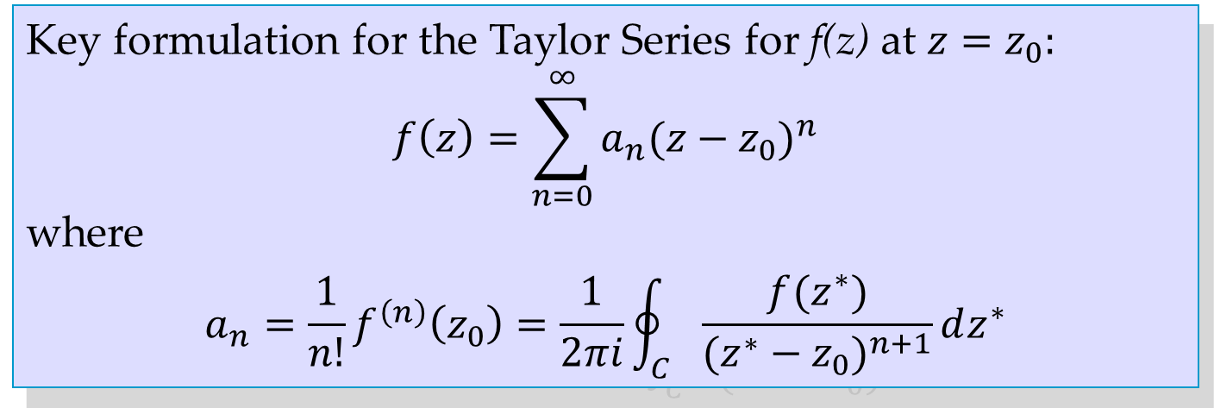
Key formulation for the Taylor Series for f(z) at $z=z_{0}:$
$$f\left(z\right)=\sum_{n=0}^{∞}{a_{n}{(z−z_{0})}^{n}}$$
where
$$a_{n}=\frac{1}{n!}f^{\left(n\right)}\left(z_{0}\right)=\frac{1}{2πi}\oint_{C}{\frac{f(z^{∗})}{{(z^{∗}−z_{0})}^{n+1}}dz^{∗}}$$

Slide 15
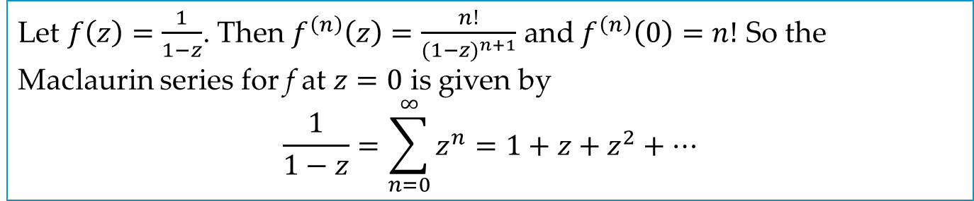
EXAMPLE 1
Let $f\left(z\right)=\frac{1}{1−z}$. Then $f^{\left(n\right)}\left(z\right)=\frac{n!}{{(1−z)}^{n+1}}$ and $f^{\left(n\right)}\left(0\right)=n!$ So the Maclaurin series for f at $z=0$ is given by
$$\frac{1}{1−z}=\sum_{n=0}^{∞}{z^{n}}=1+z+z^{2}+⋯$$

Slide 16
15.5 Uniform Convergence

Slide 17
Key properties of uniformly convergent series:
Power series are uniformly convergent on their disk of convergence.
If the terms are continuous functions and the convergence is uniform, then the sum is also continuous.
Term-by-term integration is permissible.
Under certain extra conditions, term-by-term differentiation is permissible.
There is no relation between uniform convergence and absolute convergence.

Slide 18
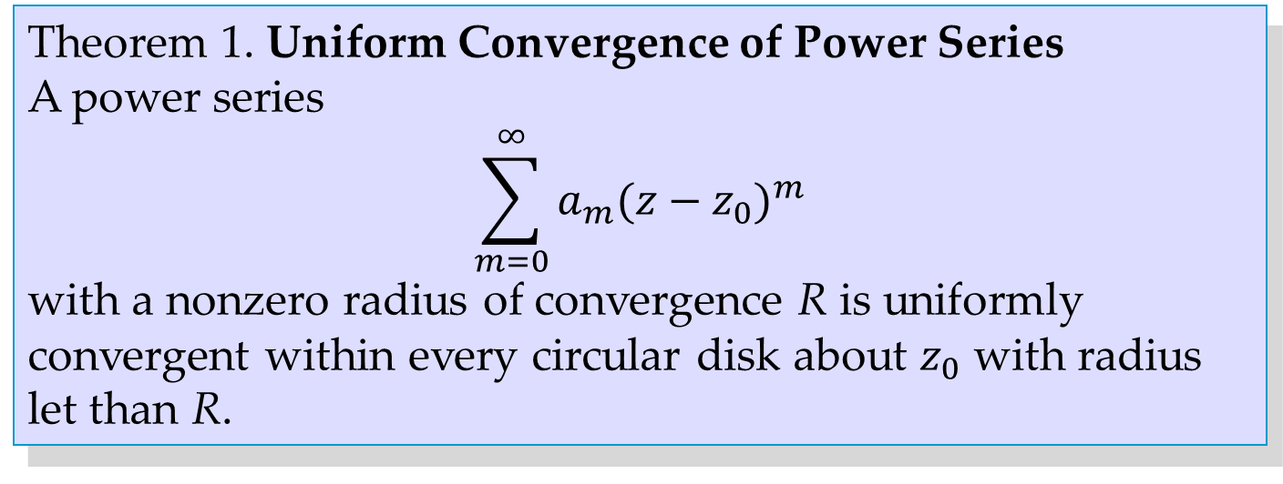
Theorem 1. Uniform Convergence of Power Series
A power series
$$\sum_{m=0}^{∞}{a_{m}{(z−z_{0})}^{m}}$$
with a nonzero radius of convergence R is uniformly convergent within every circular disk about $z_{0}$ with radius let than R.
Notes:
“less than R”

Slide 19
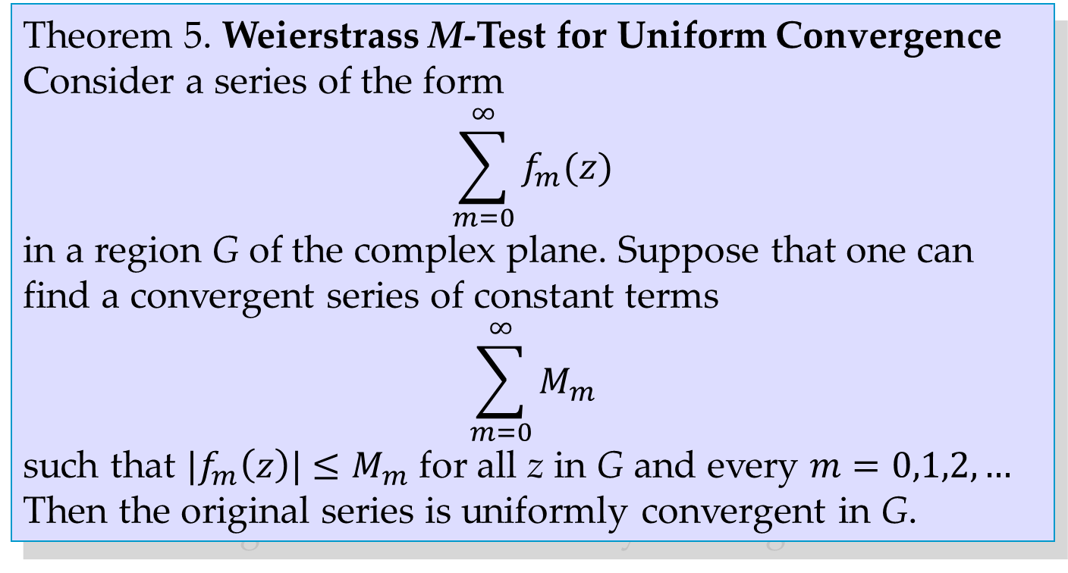
Theorem 5. Weierstrass M-Test for Uniform Convergence
Consider a series of the form
$$\sum_{m=0}^{∞}{f_{m}(z)}$$
in a region G of the complex plane. Suppose that one can find a convergent series of constant terms
$$\sum_{m=0}^{∞}{M_{m}}$$
such that $|f_{m}\left(z\right)|≤M_{m}$ for all z in G and every $m=0,1,2,…$ Then the original series is uniformly convergent in G.

Slide 20
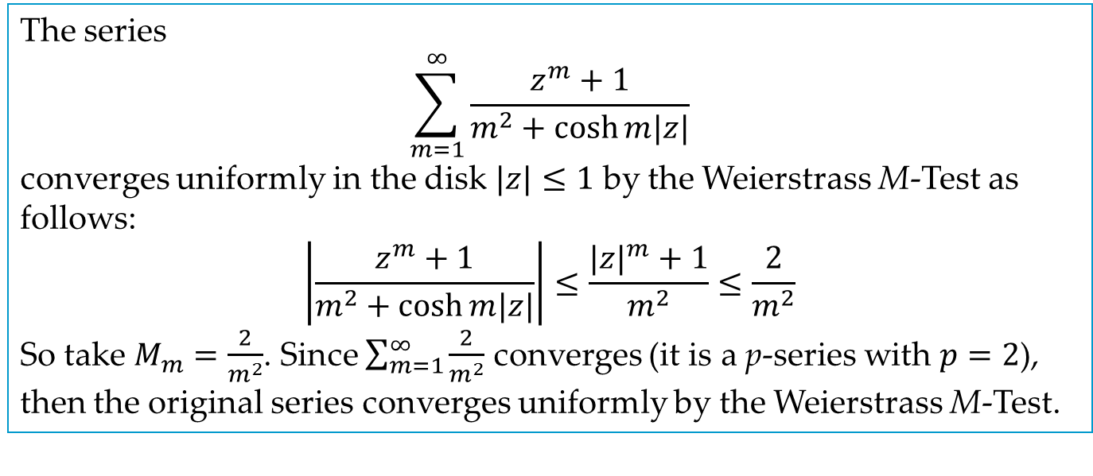
EXAMPLE 4
The series
$$\sum_{m=1}^{∞}{\frac{z^{m}+1}{m^{2}+\cosh{m|z|}}}$$
converges uniformly in the disk $|z|≤1$ by the Weierstrass M-Test as follows:
$$\left|\frac{z^{m}+1}{m^{2}+\cosh{m|z|}}\right|≤\frac{{|z|}^{m}+1}{m^{2}}≤\frac{2}{m^{2}}$$
So take $M_{m}=\frac{2}{m^{2}}$. Since $\sum_{m=1}^{∞}{\frac{2}{m^{2}}}$ converges (it is a p-series with $p=2$), then the original series converges uniformly by the Weierstrass M-Test.

